Slide 1
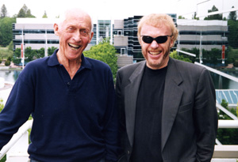
Phil Knight and Bill Bowerman
Bryan Boswell
Entrepreneurship
December 4, 2012

Slide 2
Phil Knight
Phil was born on February 24, 1938
As a native Oregonian and attended Cleveland High School in Portland.
Phil Graduated from University of Oregon and Stanford University.

Slide 3
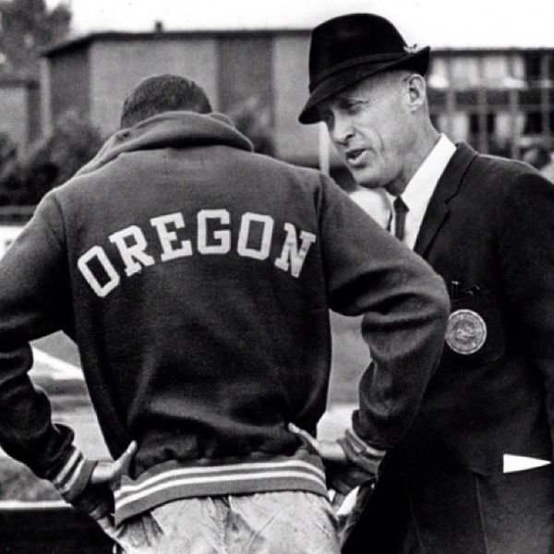
Phil Knight ran for the University of Oregon track team under his Coach Bill Bowerman.
Bill Bowerman is the Co-founder of Nike.
When Phil Knight was studying at Stanford University he discovered his love for entrepreneurship.

Slide 4
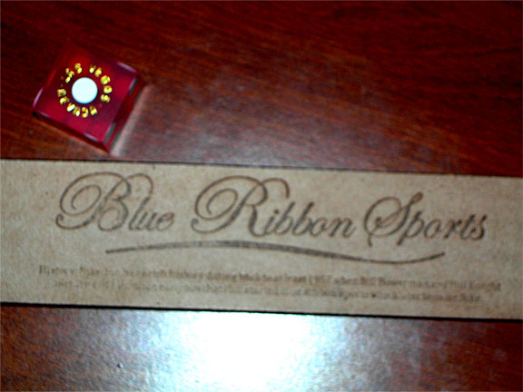
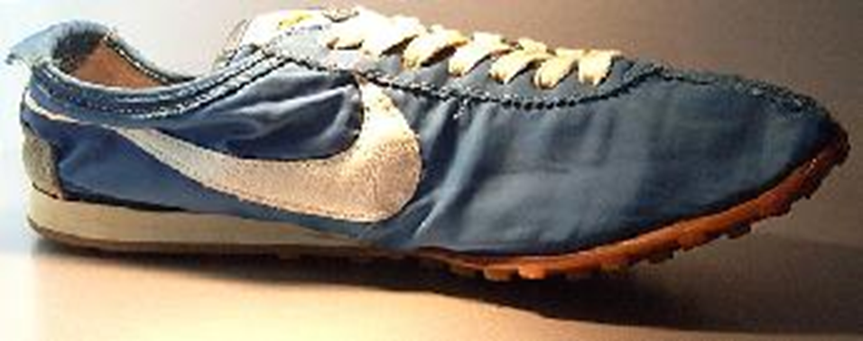
Blue Ribbon sports was created after Phil got out the Army Reserve.
Blue ribbon started selling out of the track at the.
Blue Ribbon Sports was changed to Nike which is now the most recognized name in athletic wear.

Slide 5
Born In Coos Bay Oregon on January 25 1951.
Attended Marshfield High school in 1965 where he ran cross country.
Went to the University of Oregon on a track scholarship. Ran under coach Bill Bowerman.
Phil Knight and Bill Bowerman created the first Nike shoe for him.

Slide 6
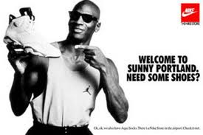
Michal Jordan has one of the most signature shoe lines today.
Air Jordan 1s was banned by NBA commissioner David Stern
Jordan was fined $5,000 for every step he took on the court wearing these shoes. Nike paid the fine after every game.
Jordan was in the first commercial that Nike did and he had one simple line stating “On October 18 the NBA through them out of the game, but they can’t stop you from wearing them”.
http://www.youtube.com/watch?v=zkXkrSLe-nQ&feature=player_embedded

Slide 7
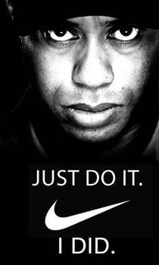
Tiger woods was signed on to be a Nike sponsored athlete at 20 years old.
When people think about gold the most popular name that people know is Tiger Woods.
Nike has changed the game of golf by creating some of the most used gold clubs with the best technology.

Slide 8
Bibliography
(Krentzman, 1997)
(Gunderson, Nov 4, 2009)
(This Day In Sneaker History…, 778 days ago)
(Wikipedia, 2012)
(44\AppData\Local\Temp\Temp1_Hotmail.zip\phil-knight.htm)
http://en.wikipedia.org/wiki/Steve_Prefontaine

